Slide 1
Project presentation
Submitted to :
Ashfaq Ali Shafin
Lecturer
Dept. of CSE
Stamford University ,Bangladesh
Submitted by:
Group name :
( Creative Originality )
Tahmim Al Ashik CSE06307448
Sharmi Mondal CSE06307454
Jafor Iqbal CSE06307452

Slide 2
Proposed Project Xpharma Intro and Product

Slide 3
Overview
INTRODUCTION
CONTRIBUTION
REQUIREMENTS
FEASIBILITY
PROJECT VIEW REFERENCE
FUTURE SCOPE
CONCLUSION

Slide 4
introduction
We have done a project on a pharmaceutical company intro and product list of that pharmaceutical. Its name is ‘Xpharma intro and product’. Bangladesh has become a largest pharmaceutical product producer country .So we need to create more attachment with modern software in this sector. From this point of view and following lot of discussion we have decided to make it .This system software does not mean drug house products management tools. It has created on the basis of a significant pharmaceutical company product list and their information.
.

Slide 5
Contribution
Contribution from our group member :
1. Tahmim Al Ashik (cse06307448) – 45%
2. Sharmi Mondal (cse06307454) – 35%
3. Jafor Iqbal (cse06307452) – 20%

Slide 6
Hardware requirement
* Laptop or Pc
* Android Phone

Slide 7
Software requirement
Any version of windows Operating System
Java fx ,JDK and SQLite
Android studio and SQLite
Raw elements are :
HTML
CSS
PHP
JS
Android Studio
Java
PHP server
My SQL

Slide 8
Feasibility
Technical Feasibility
This is concerned with specifying equipment and software that will successfully satisfy the user requirement. In examine
Technical feasibility ,
Configuration of the system is given more importance than the actual make of hardware.
How many workstations are required
How these units are interconnected so that they could operate and communicate smoothly

Slide 9
Feasibility
Economical Feasibility
Economic analysis is the most frequently used technique for evaluating the effectiveness of a proposed system. More frequently known as cost-benefit analysis.
The procedure is to determine the benefits and savings that are expected from a proposed system and compare them with costs
If benefits outweigh costs , a decision is taken to design and implement the system

Slide 10
Feasibility
Social Feasibility
Social feasibility is a determination of whether a proposed project will be acceptable to the people or not.
Management Feasibility
It is a determination of whether a proposed project will be acceptable to management. If does not accept a project or gives a negligible support to it ; the analyst will tend to view the project as a non feasible one

Slide 11
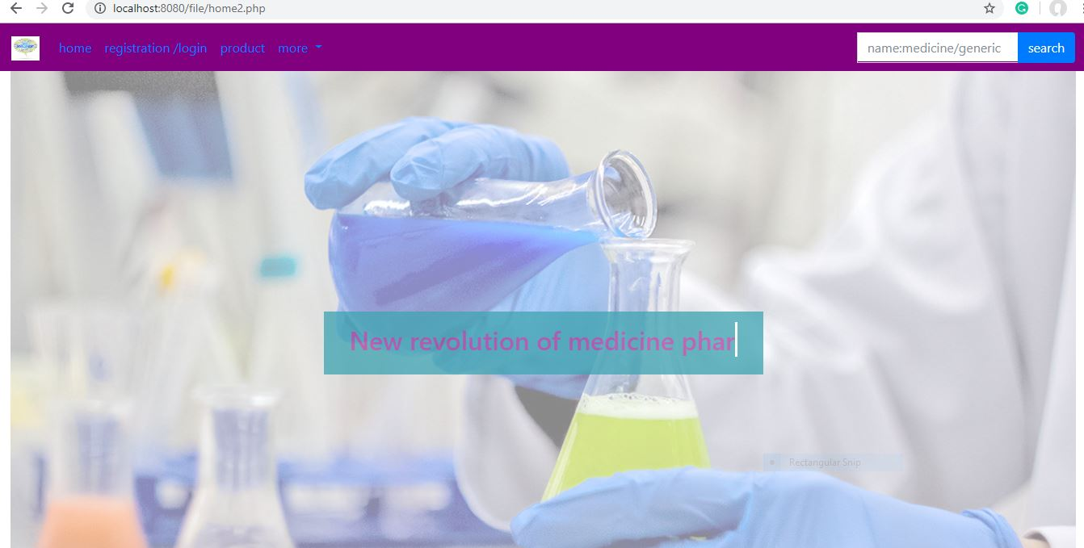
Project view

Slide 12
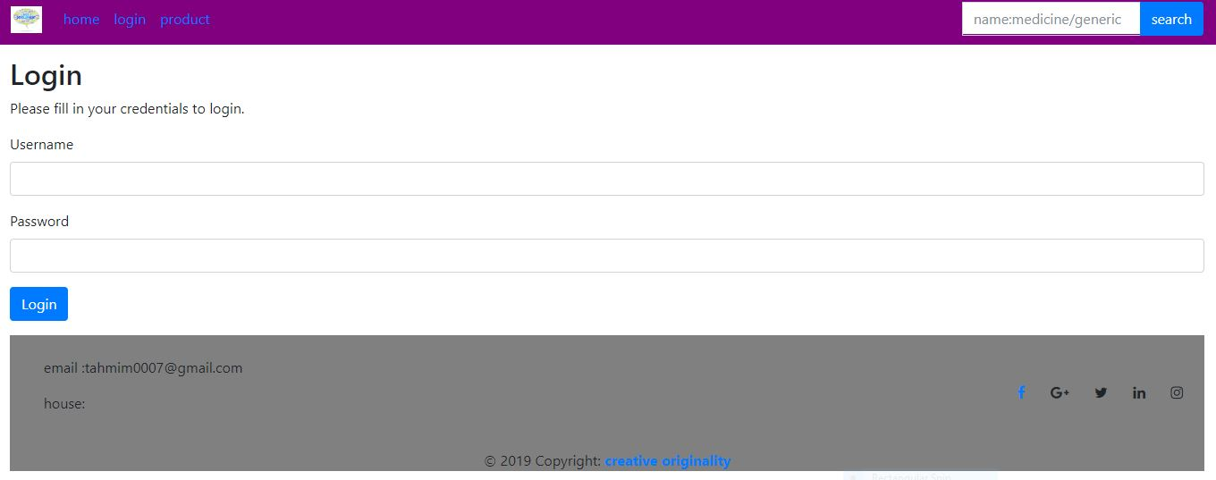
Project view

Slide 13
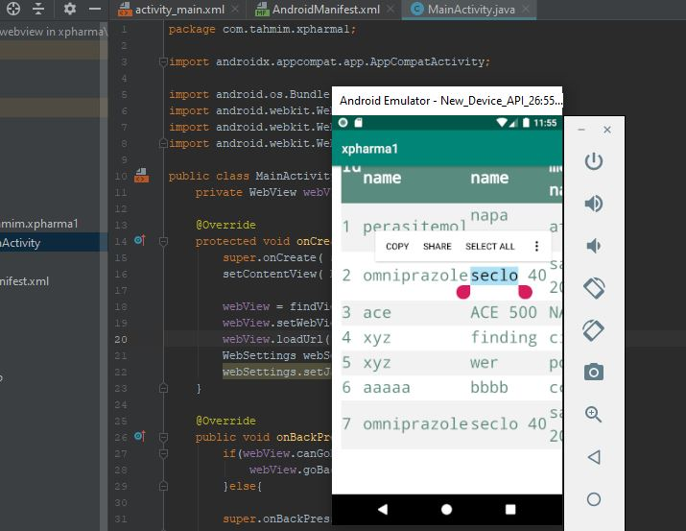
Project view

Slide 14
Future Scope
BANGLADESH HAVE ALMOST 1000+ PHARMACEUTICAL MEDICINE COMPNAY
97% MEDICINE OF LOCAL MARKET ARE SUPPLIED BY THEM
THIS SECTOR CAN BE ONE OF THE LARGEST FOREIGN MONEY INCOME SECTOR
MARKET VALUE OF THIS SECTOR IS AROUND 200 BILLION TAKA
[ACCORDING TO GOOGLE]
So it is vast place to work on. Even consistent development process make it more powerful.

Slide 15
conclusion
We have done our project sincerely. If any issues arise here , that will be resolved by us .Though we have fulfilled all requirements and all sections but this is first development of this tool so if there need to further improvement then that will make it more powerful and more advance .

Slide 16
Thank you to all

